Slide 1
HDL 1 - Combinational Circuit
Nahin Ul Sadad/Utsha Das
Ass. Professor/Lecturer
CSE, RUET

Slide 2
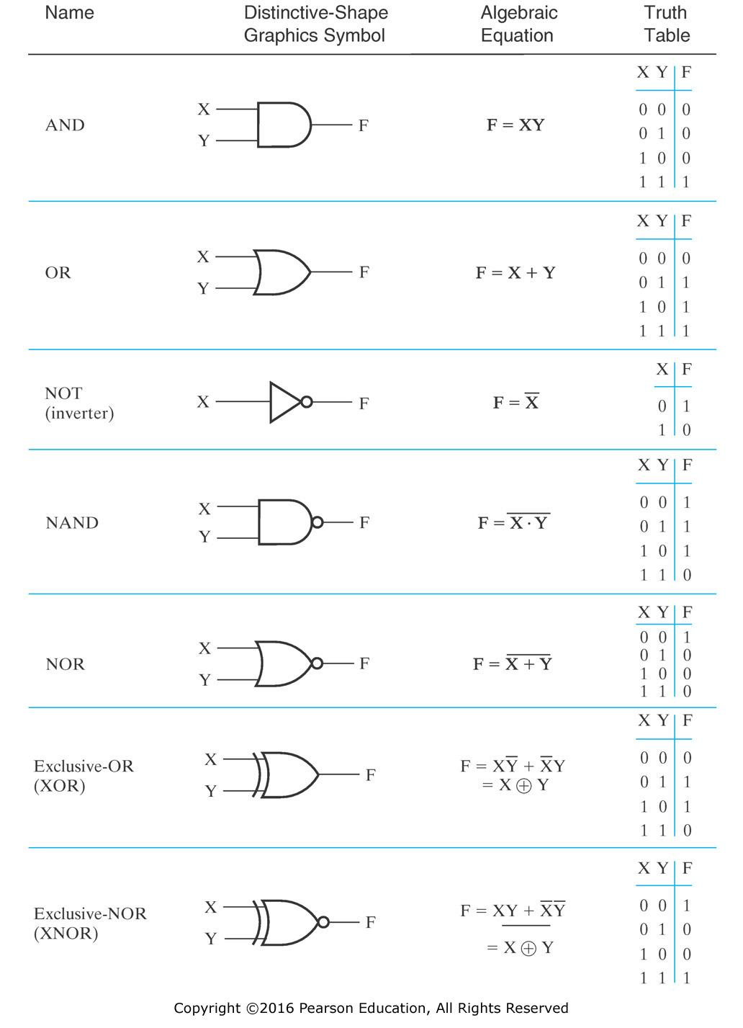
Digital Electronics
Digital Electronics:
Digital Electronics deal with binary numbers. Logic gates are building blocks of digital electronics. There are two types of digital electronics circuit. They are: Combinational Circuit and Sequential Circuit

Slide 3
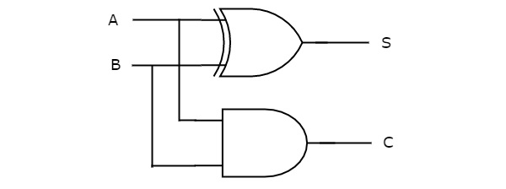
Digital Electronics (Combinational Circuit)
Combinational Circuit:
Output of combinational circuit only depends on present inputs. Combinational Circuit is instantaneous. It will give output instantly when it is given inputs. Applications of combinational circuit: Arithmetic and Logic Unit (ALU) Implementation etc.
Example: Half Adder
Inputs |  | Outputs
A | B | Carry, C | Sum, S
0 | 0 | 0 | 0
0 | 1 | 0 | 1
1 | 0 | 0 | 1
1 | 1 | 1 | 0
a
s
b
c
Fig: Half Adder
Fig: Half adder chip

Slide 4
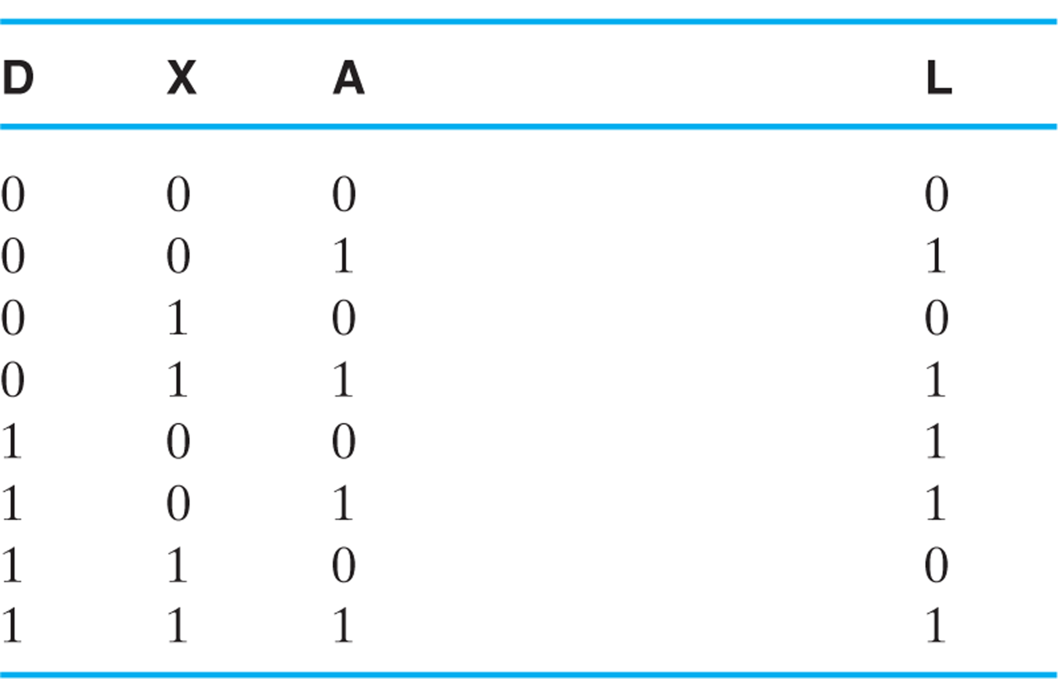
Combinational Circuit
Truth Table

Slide 5
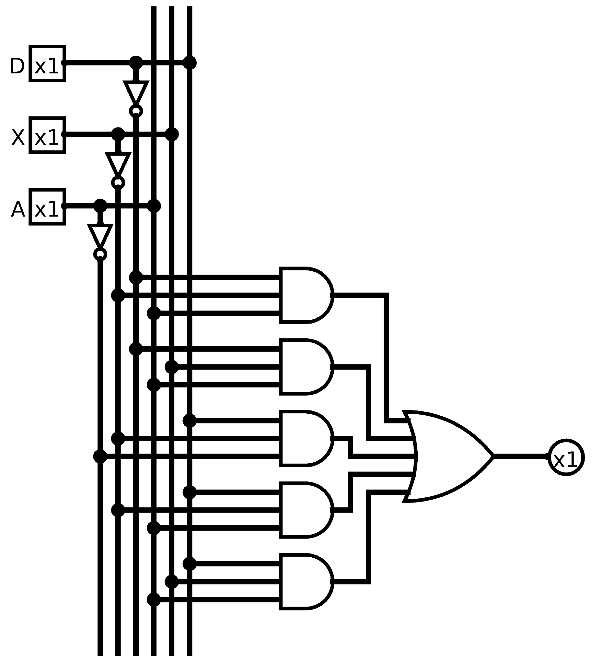
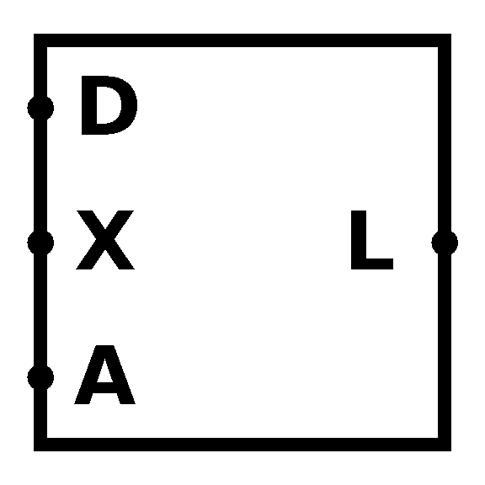
Combinational Circuit
Module of L
Combinational Circuit of L

Slide 6
Combinational Circuit
Verilog code of previous circuit is shown below:
comb1.v
module comb1 ( input D, input X, input A, output L ); assign L = (~D)&(~X)&A | (~D)&X&A | D&(~X)&(~A) | D&(~X)&A | D&X&A; endmodule

Slide 7
Combinational Circuit
Verilog code of test bench of previous circuit is shown below:
comb1_tb.v
`timescale 1ns/1ps module comb1_tb; reg D; reg X; reg A; wire L; comb1 uut ( .D(D), .X(X), .A(A), .L(L) ); | initial begin D = 0; X = 0; A = 0; #20; A = 1; #20; X = 1; #20; D = 1; | #20; X = 0; #20; A = 0; #20; end initial begin $monitor("D=%d X=%d A=%d L=%d\n", D, X, A, L); end endmodule

Slide 8
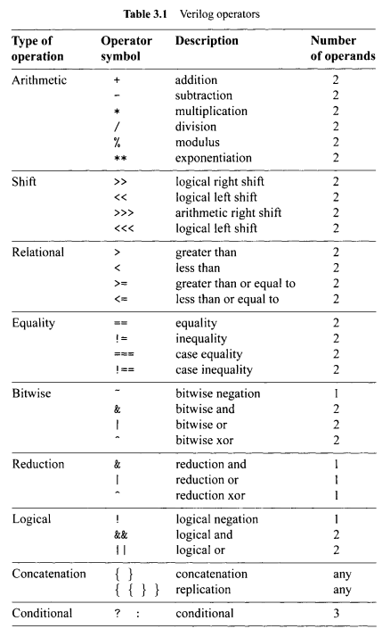
Combinational Circuit
Figure: Verilog Operators
To know more about Verilog Operators, follow this link: https://www.chipverify.com/verilog/verilog-operators
Notes:
Reduction AND operator performs logical AND operations between all the bits of the operand. Result is one bit bollean value.

Slide 9
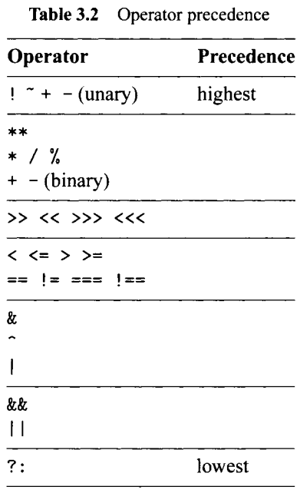
Combinational Circuit
Figure: Verilog Operators

Slide 10
Combinational Circuit
Verilog code of previous circuit is shown below:
comb2.v
module comb2 ( input [3:0] A, input [3:0] B, input [3:0] C, input [3:0] D, output [3:0] Arithmetic, output [3:0] Shift, output [3:0] Relational, output [3:0] Equality, output [3:0] Bitwise, output [3:0] Reduction, output [3:0] Logical, output [3:0] Concatenation, output [3:0] Conditional ); | assign Arithmetic = B+C; assign Shift = B>>C; assign Relational = A > B; assign Equality = A == D; assign Bitwise = B & C; assign Reduction = |B; assign Logical = (A > B) || (A > D); assign Concatenation = {C[1:0], D[3:2]}; assign Conditional = (A>B) ? A : B; endmodule

Slide 11
Combinational Circuit
Verilog code of test bench of previous circuit is shown below:
comb2_tb.v
`timescale 1ns/1ps module comb2_tb; reg [3:0] A; reg [3:0] B; reg [3:0] C; reg [3:0] D; wire [3:0] Arithmetic; wire [3:0] Shift; wire [3:0] Relational; wire [3:0] Equality; wire [3:0] Bitwise; wire [3:0] Reduction; wire [3:0] Logical; wire [3:0] Concatenation; wire [3:0] Conditional; | comb2 uut ( .A(A), .B(B), .C(C), .D(D), .Arithmetic(Arithmetic), .Shift(Shift), .Relational(Relational), .Equality(Equality), .Bitwise(Bitwise), .Reduction(Reduction), .Logical(Logical), .Concatenation(Concatenation), .Conditional(Conditional) );

Slide 12
Combinational Circuit
Simulation Result
initial begin A = 4'b1100; B = 4'b0110; C = 4'b0010; D = 4'b1100; #20; end initial begin $monitor("A=%4b, B=%4b, C=%4b, D=%4b\n", A, B, C, D, "Arithmetic=%4b, Shift=%4b, Relational=%4b\n", Arithmetic, Shift, Relational, "Equality=%4b, Bitwise=%4b, Reduction=%4b\n", Equality, Bitwise, Reduction, "Logical=%4b, Concatenation=%4b, Conditional=%4b\n", Logical, Concatenation, Conditional); end endmodule
A=1100, B=0110, C=0010, D=1100 Arithmetic=1000, Shift=0001, Relational=0001 Equality=0001, Bitwise=0010, Reduction=0001 Logical=0001, Concatenation=1011, Conditional=1100

Slide 13
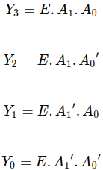
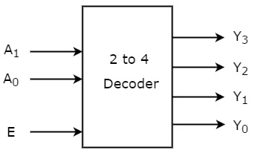
Combinational Circuit
Decoder
Decoder is a combinational circuit that has ‘n’ input lines and maximum of 2^n output lines. One of these outputs will be active High based on the combination of inputs present, when the decoder is enabled. That means decoder detects a particular code.
Table: Truth Table of 2 to 4 Decoder
Enable | Inputs |  | Outputs
E | A1 | A0 | Y3 | Y2 | Y1 | Y0
0 | x | x | 0 | 0 | 0 | 0
1 | 0 | 0 | 0 | 0 | 0 | 1
1 | 0 | 1 | 0 | 0 | 1 | 0
1 | 1 | 0 | 0 | 1 | 0 | 0
1 | 1 | 1 | 1 | 0 | 0 | 0

Slide 14
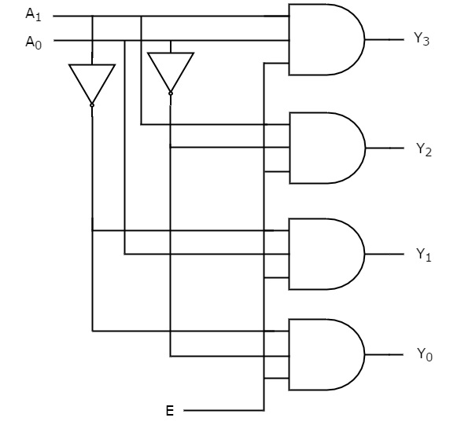
Combinational Circuit
Decoder
Table: Truth Table of 2 to 4 Decoder
Enable | Inputs |  | Outputs
E | A1 | A0 | Y3 | Y2 | Y1 | Y0
0 | x | x | 0 | 0 | 0 | 0
1 | 0 | 0 | 0 | 0 | 0 | 1
1 | 0 | 1 | 0 | 0 | 1 | 0
1 | 1 | 0 | 0 | 1 | 0 | 0
1 | 1 | 1 | 1 | 0 | 0 | 0
Figure: 2 to 4 Decoder Circuit

Slide 15
Combinational Circuit
Decoder in HDL (using assign statement)
decoder2to4.v
module decoder2to4 ( input [1:0] A, input E, output [3:0] Y ); assign Y[3] = E & A[1] & A[0]; assign Y[2] = E & A[1] & ~A[0]; assign Y[1] = E & ~A[1] & A[0]; assign Y[0] = E & ~A[1] & ~A[0]; endmodule

Slide 16
Combinational Circuit
Decoder Testbench in HDL
decoder2to4_tb.v
`timescale 1ns/1ps module decoder2to4_tb; reg [1:0] A; reg E; wire [3:0] Y; decoder2to4 uut ( .A(A), .E(E), .Y(Y) ); initial begin A[1] = 0; A[0] = 0; E = 0; |  | #20; E = 1; #20; A[0] = 1; #20; A[1] = 1; #20; A[0] = 0; #20; end initial begin $monitor("E=%d A[1]=%d A[0]=%d Y[3]=%d Y[2]=%d Y[1]=%d Y[0]=%d\n", E, A[1], A[0], Y[3], Y[2], Y[1], Y[0]); end endmodule

Slide 17
Combinational Circuit
ALWAYS BLOCK for a Combinational Circuit
To facilitate system modeling, Verilog contains a number of procedural statements, which are executed in sequence. Since their behavior is different from the normal concurrent circuit model, these statements are encapsulated inside an always block. Syntax for always block is shown below:
always @([sensitivity-list]) begin [optional name] [optional local variable declaration]; [procedural statement]; [procedural statement]; end
The [sensitivity-list] term is a list of signals and events to which the always block responds (i.e., is "sensitive to"). For a combinational circuit, all the input signals should be included in this list. We use asterisk (*) to include all the input signals in this list.
We can use always block instead of assign statement because always block allow us to use if statement and case statement to implement combinational circuit.

Slide 18
Combinational Circuit
ALWAYS BLOCK for a Combinational Circuit
A procedural assignment can only be used within an always block or initial block. There are two types of assignments: blocking assignment and nonblocking assignment. Their basic syntax is:
[variable-name] = [expression]; // blocking assignment [variable-name] <= [expression]; // nonblocking assignment
In a blocking assignment, the expression is evaluated and then assigned to the variable immediately, before execution of the next statement (the assignment thus "blocks" the execution of other statements). It behaves like the normal variable assignment in the C language.
In a nonblocking assignment, the evaluated expression is assigned at the end of the always block (the assignment thus does not block the execution of other statements).
The basic rule of thumb is:
Use blocking assignments for a combinational circuit.
Use nonblocking assignments for a sequential circuit.

Slide 19
Combinational Circuit
Decoder in HDL (Using always block and if statement)
decoder2to4T2.v
module decoder2to4T2 ( input [1:0] A, input E, reg [3:0] Y ); |  | always @* begin if(E == 1'b0) Y = 4'b0000; else if (A == 2'b00) Y = 4'b0001; else if (A == 2'b01) Y = 4'b0010; else if (A == 2'b10) Y = 4'b0100; else Y = 4'b1000; end endmodule

Slide 20
Combinational Circuit
Decoder Testbench in HDL
decoder2to4T2_tb.v
`timescale 1ns/1ps module decoder2to4_tb; reg [1:0] A; reg E; wire [3:0] Y; decoder2to4T2 uut ( .A(A), .E(E), .Y(Y) ); initial begin A[1] = 0; A[0] = 0; E = 0; |  | #20; E = 1; #20; A[0] = 1; #20; A[1] = 1; #20; A[0] = 0; #20; end initial begin $monitor("E=%d A[1]=%d A[0]=%d Y[3]=%d Y[2]=%d Y[1]=%d Y[0]=%d\n", E, A[1], A[0], Y[3], Y[2], Y[1], Y[0]); end endmodule

Slide 21
Combinational Circuit
Decoder in HDL (Using always block and case statement)
decoder2to4T3.v
module decoder2to4T2 ( input [1:0] A, input E, reg [3:0] Y ); |  | always @* begin case({E,A}) 3'b100: Y = 4'b0001; 3'b101: Y = 4'b0010; 3'b110: Y = 4'b0100; 3'b111: Y = 4'b1000; default: Y = 4'b0000; endcase end endmodule

Slide 22
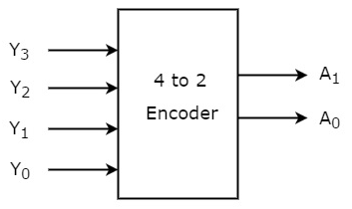
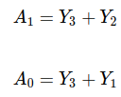
Combinational Circuit
Encoder
An Encoder is a combinational circuit that performs the reverse operation of Decoder. It has maximum of 2^n input lines and ‘n’ output lines. It will produce a binary code equivalent to the input, which is active High.
Table: Truth Table of 4 to 2 Encoder
Inputs |  |  |  | Outputs
Y3 | Y2 | Y1 | Y0 | A1 | A0
0 | 0 | 0 | 1 | 0 | 0
0 | 0 | 1 | 0 | 0 | 1
0 | 1 | 0 | 0 | 1 | 0
1 | 0 | 0 | 0 | 1 | 1

Slide 23
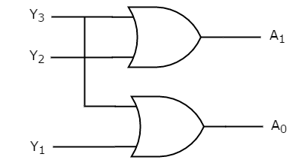
Combinational Circuit
Encoder
Table: Truth Table of 4 to 2 Encoder
Inputs |  |  |  | Outputs
Y3 | Y2 | Y1 | Y0 | A1 | A0
0 | 0 | 0 | 1 | 0 | 0
0 | 0 | 1 | 0 | 0 | 1
0 | 1 | 0 | 0 | 1 | 0
1 | 0 | 0 | 0 | 1 | 1
Figure: 4 to 2 Encoder

Slide 24

Combinational Circuit
Priority Encoder
A 4 to 2 priority encoder has four inputs Y3, Y2, Y1 & Y0 and two outputs A1 & A0. Here, the input, Y3 has the highest priority, whereas the input, Y0 has the lowest priority. In this case, even if more than one input is ‘1’ at the same time, the output will be the binary code corresponding to the input, which is having higher priority.
Table: Truth Table of 4 to 2 Priority Encoder
Inputs |  |  |  | Outputs
Y3 | Y2 | Y1 | Y0 | A1 | A0
0 | 0 | 0 | 0 | 0 | 0
0 | 0 | 0 | 1 | 0 | 0
0 | 0 | 1 | x | 0 | 1
0 | 1 | x | x | 1 | 0
1 | x | x | x | 1 | 1

Slide 25
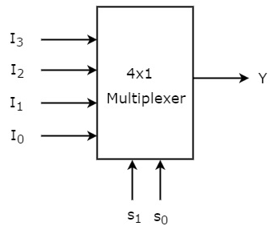
Combinational Circuit
Multiplexer
Multiplexer is a combinational circuit that has maximum of 2^n data inputs, ‘n’ selection lines and single output line. One of these data inputs will be connected to the output based on the values of selection lines.
Table: Truth Table of 4x1 Multiplexer
Selection Lines |  | Output
S1 | S0 | Y
0 | 0 | I0
0 | 1 | I1
1 | 0 | I2
1 | 1 | I3

Slide 26
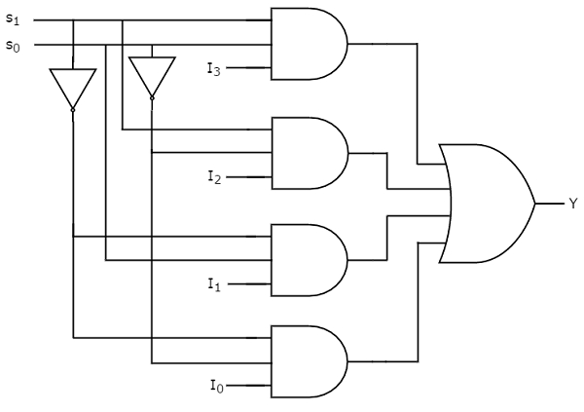
Combinational Circuit
Multiplexer
Table: Truth Table of 4x1 Multiplexer
Selection Lines |  | Output
S1 | S0 | Y
0 | 0 | I0
0 | 1 | I1
1 | 0 | I2
1 | 1 | I3
Figure: 4x1 Multiplexer

Slide 27
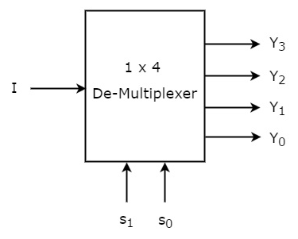
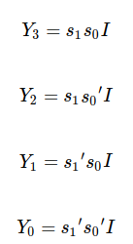
Combinational Circuit
Demultiplexer
De-Multiplexer is a combinational circuit that performs the reverse operation of Multiplexer. It has single input, ‘n’ selection lines and maximum of 2^n outputs. The input will be connected to one of these outputs based on the values of selection lines.
Table: Truth Table of 1x4 Demultiplexer
Selection Inputs |  | Outputs
S1 | S0 | Y3 | Y2 | Y1 | Y0
0 | 0 | 0 | 0 | 0 | I
0 | 1 | 0 | 0 | I | 0
1 | 0 | 0 | I | 0 | 0
1 | 1 | I | 0 | 0 | 0

Slide 28
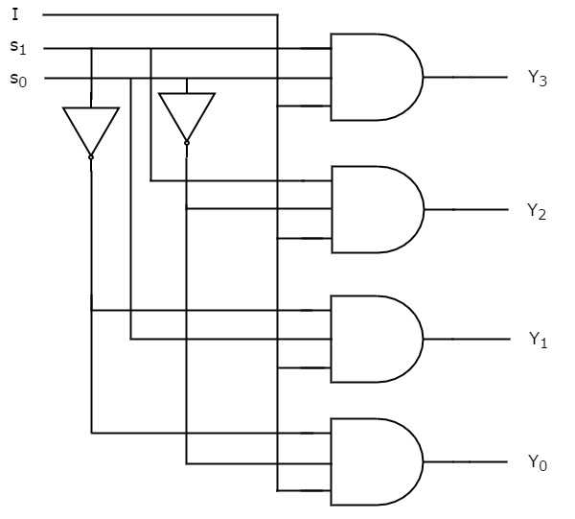
Combinational Circuit
Demultiplexer
Table: Truth Table of 1x4 Demultiplexer
Selection Inputs |  | Outputs
S1 | S0 | Y3 | Y2 | Y1 | Y0
0 | 0 | 0 | 0 | 0 | I
0 | 1 | 0 | 0 | I | 0
1 | 0 | 0 | I | 0 | 0
1 | 1 | I | 0 | 0 | 0
Figure: 1x4 Demultiplexer

Slide 29
Example: Verilog
Question: Implement a 2 to 4 Decoder in Verilog HDL along with a test bench.
Answer:
Boolean Table is shown below:
Table: Truth Table of 2 to 4 Decoder
Enable | Inputs |  | Outputs
E | A1 | A0 | Y3 | Y2 | Y1 | Y0
0 | x | x | 0 | 0 | 0 | 0
1 | 0 | 0 | 0 | 0 | 0 | 1
1 | 0 | 1 | 0 | 0 | 1 | 0
1 | 1 | 0 | 0 | 1 | 0 | 0
1 | 1 | 1 | 1 | 0 | 0 | 0

Slide 30
Example: Verilog
Verilog code of 2 to 4 Decoder is shown below:
decoder2to4.v
module decoder2to4T2 ( input [1:0] A, input E, reg [3:0] Y ); always @* begin if(E == 1'b0) Y = 4'b0000; else if (A == 2'b00) Y = 4'b0001; else if (A == 2'b01) Y = 4'b0010; else if (A == 2'b10) Y = 4'b0100; else Y = 4'b1000; end endmodule

Slide 31
Example: Verilog
Test bench of 2 to 4 Decoder is shown below:
decoder2to4_tb.v
`timescale 1ns/1ps module decoder2to4_tb; reg [1:0] A; reg E; wire [3:0] Y; decoder2to4T2 uut ( .A(A), .E(E), .Y(Y) ); initial begin A[1] = 0; A[0] = 0; E = 0;

Slide 32
Example: Verilog
#20; E = 1; #20; A[0] = 1; #20; A[1] = 1; #20; A[0] = 0; #20; end initial begin $monitor("E=%d A[1]=%d A[0]=%d Y[3]=%d Y[2]=%d Y[1]=%d Y[0]=%d\n", E, A[1], A[0], Y[3], Y[2], Y[1], Y[0]); end endmodule

Slide 33
Exercises
Implement following:
3 to 8 Decoder
4 to 2 Priority Encoder
4 to 1 Multiplexer
1 to 4 Demultiplexer
in Verilog HDL along with a test bench.
Using assign statement
Using if else statement
Using case statement

Slide 34
Thank You ☺

